Slide 1
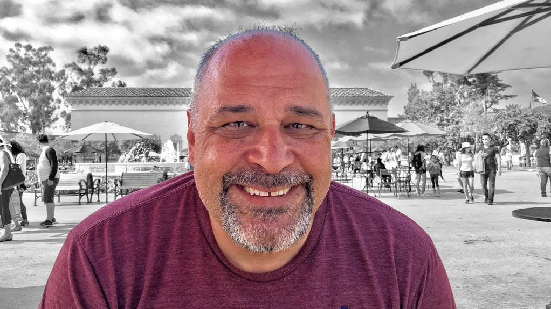
Computer Systems and C Programming
Prof. Darrell Long
CSE 13S
When the going gets weird, the weird turn pro. —Dr. Hunter S. Thompson

Slide 2
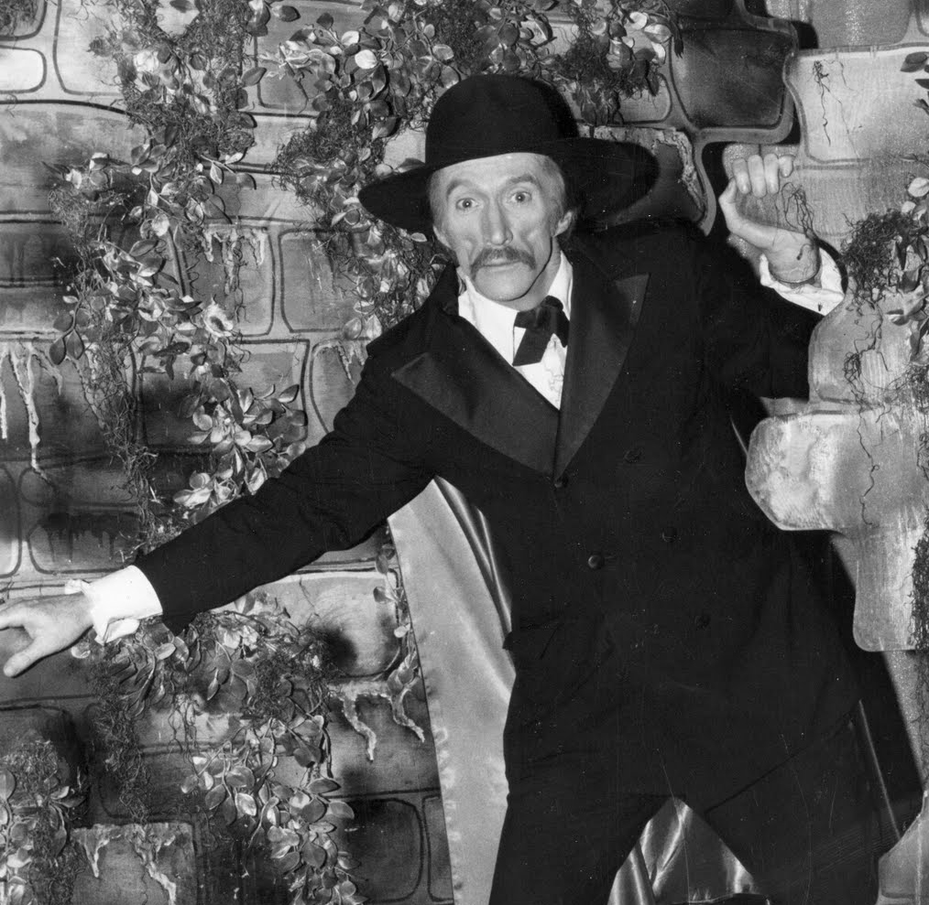
This is a hard class
This course is foundational.
What you learn will be used from now on.
It is 7 Units, combining the old CMPE 13 and CMPE 13L.
You must pass all laboratory components to pass the course.
That fact is not meant to scare you

Slide 3



Slide 4
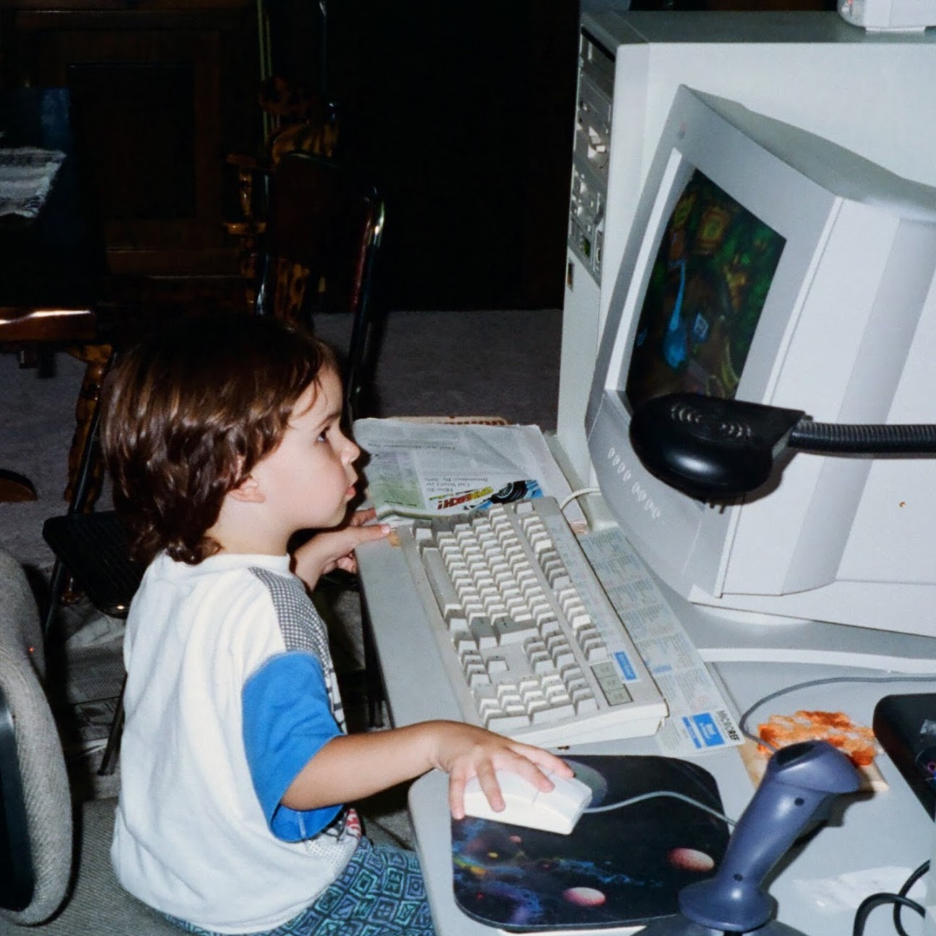
What am I expected to know?
Timon & Pumbaa’s Jungle Adventure
High school algebra:
Ideally, you know a little Calculus.
How to compose a paragraph in English.
Some exposure to programming, for example, Python.
The material from CSE 12/L:
Binary Arithmetic
Memory
Registers
Pointers
Instructions
Addressing modes
John Long
Video Game Test Engineer

Slide 5
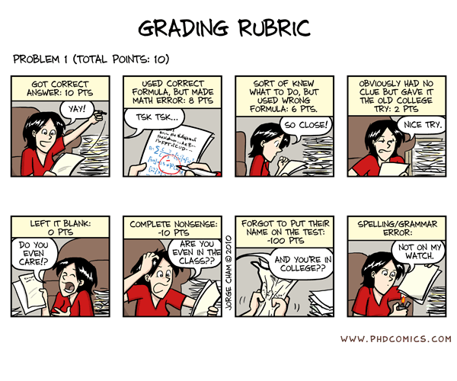
Grading
Assignments: 50%
Examinations: 30%
Quizzes: 20%
We do not have the resources to grade extra credit.
Be sure that you do each and every assignment.
You must pass every assignment in order to pass the class.
Notes:
Photo from the movie Evil Dead.

Slide 6
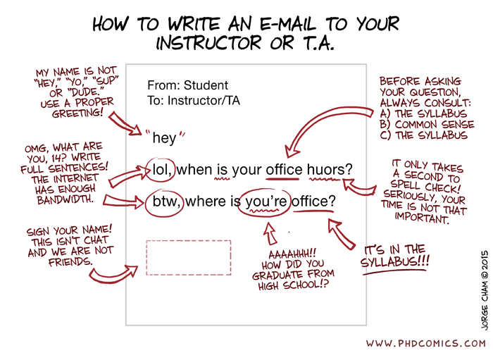
Be nice to the TA

Slide 7
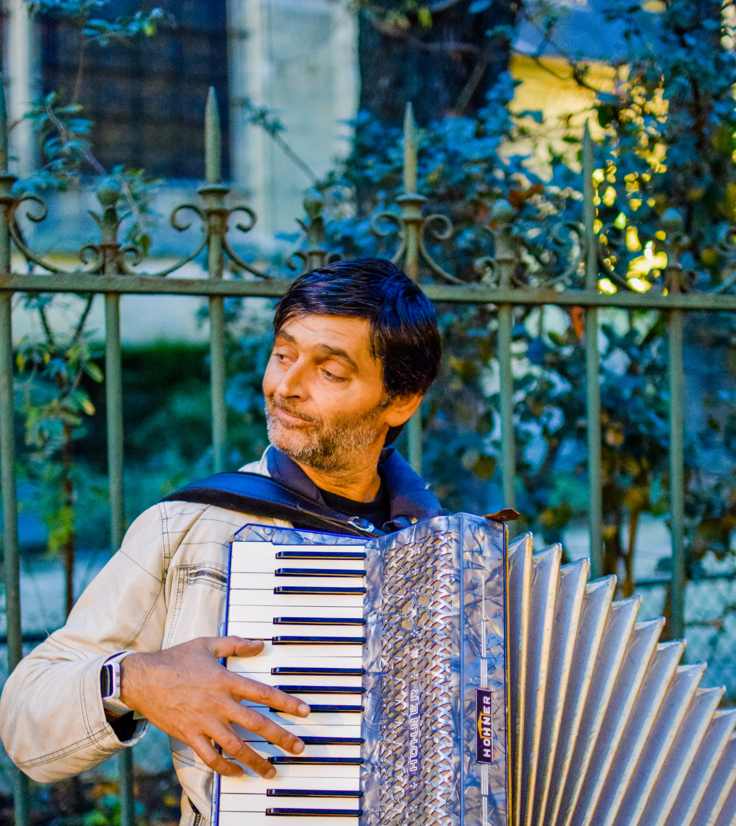
DRC Accommodations
I must remember to tell them in advance!
Sabrina Au (TA) will act as coordinator.
We can accommodate your testing requirements.
We can offer at most 2 extras days for programs.
2× on tests does not mean double time for programs.
If you are going to be late, you must tell us 2 days in advance!

Slide 8
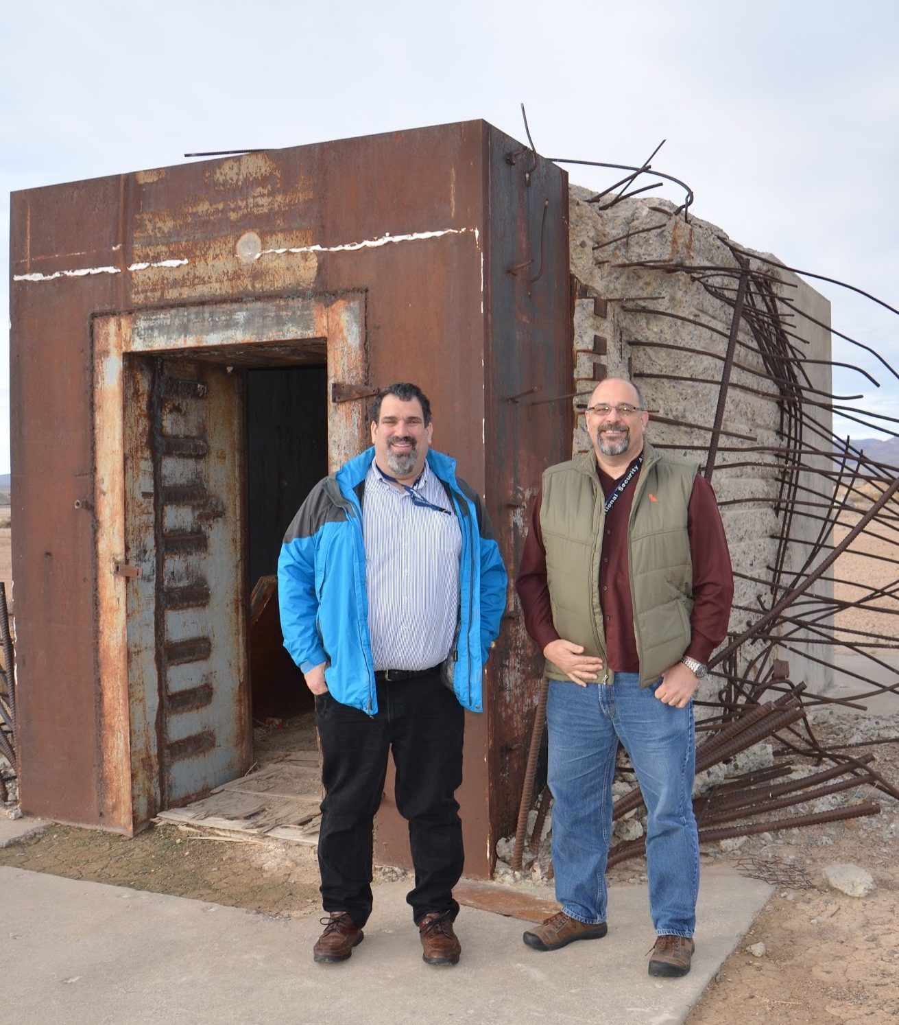
Forms of Address
Bank vault destroyed by an atomic bomb
Dr. Miller
Dr. Long
You can call me:
Dr. Long
Prof. Long
Monsieur le Professeur Long
No one calls me by my first name, except my wife.
I will address you in any manner that you prefer, so long as it is polite.
If I forget, just remind me.
I once had a student named Superman. Yes, it was his real name.

Slide 9
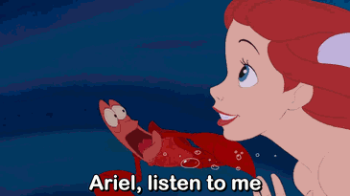
You will write a lot of programs in C
You may have seen Java or Python, but now it’s time to learn C.
You will:
… need to worry about memory,
... use pointers,
... manipulate bits,
... use an actual editor,
... use UNIX (Linux), and
... use tools like git, vim, make, cc, lldb, etc.

Slide 10
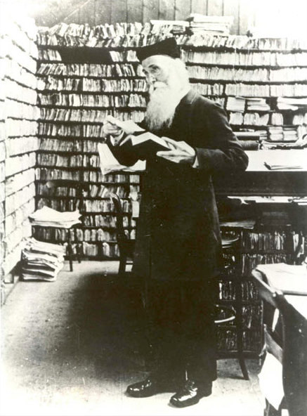
You will be busy
Do not think that you can do it the night before…
Do not think you can do it the day before that…
In other words, start on it early.
Programming requires practice.
It requires thought.
It requires the willingness to rewrite your code.
Sir James Augustus Henry Murray, LL.D.

Slide 11

You will get your hands dirty!
This class will show you where the bits hit the silicon.
You will write most of the code that you use:
In contrast to some classes which teach you which libraries to use and give you code templates to fill in.
Ever wonder how a Python dictionary works?
You’re going to find out, it’s called a hash table.
How about those lists in Python?
We will look at arrays as well as linked lists.
Mike Rowe
A Personal Hero

Slide 12

Reading
Necronomicon
So many students have suffered for failing to read the book…
In order to succeed in your classes you must read the material.
You cannot pass this course by simply:
… listening to lectures,
… reading these slides, or
… watching YouTube videos.
Read the appropriate section of the relevant book before you ask me, the TA, or the Tutor for help.
If you have not done your part and completed the reading, you will go to the back of the line so that we can help students who have done the reading.
Notes:
Photo from the movie Evil Dead.

Slide 13
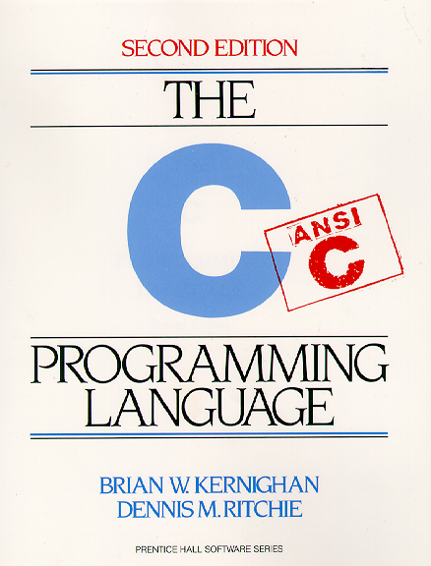
The C Programming Language
The beauty and the danger of C is its simplicity.
C gives you more access to the raw machine than any language other than assembly language.
C does not hold your hand. It will not protect you from your mistakes.
C requires you to think about what you are doing.
C will do exactly what you ask of it.
It is rather like giving a monkey a chainsaw.
Notes:
Treebuzz.com

Slide 14
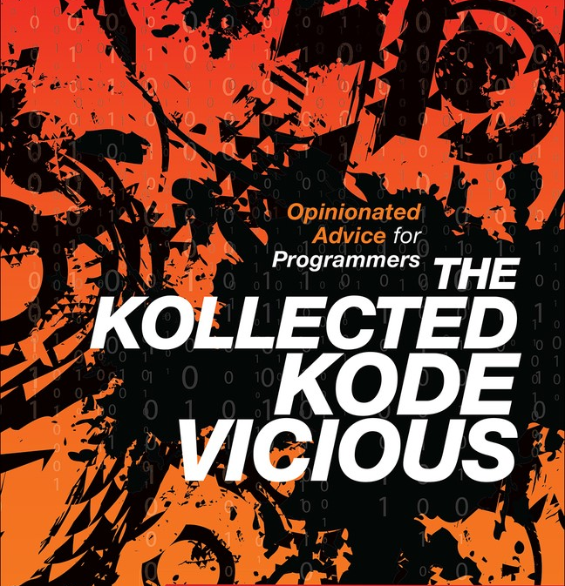
It’s about learning how to program
Programming is not simply learning C, or Java, or Python.
It is learning how to think!
There is a lot of difference between an adequate programmer and a good programmer,
And even more difference between a good program and a great programmer.
Get the book, it’s free to you on O’Reilly!
The difference between theory and practice is greater in practice than in theory. —John Wilkes

Slide 15
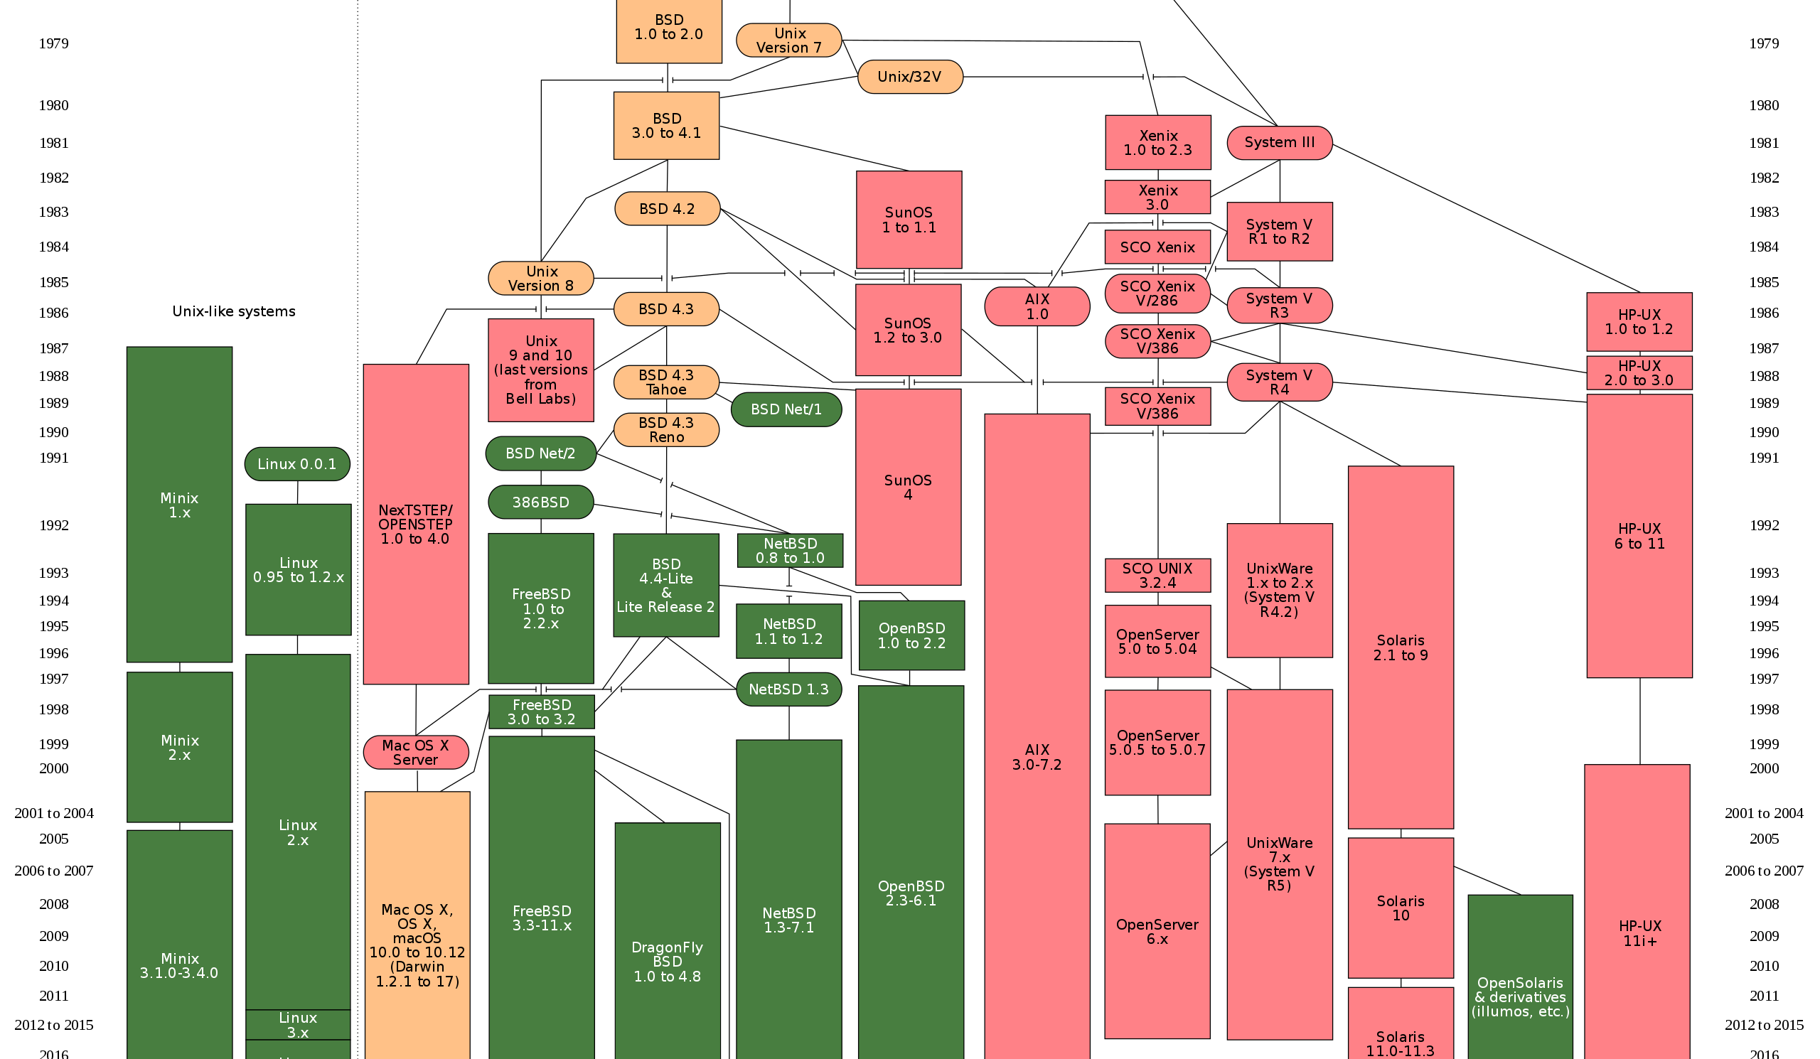
The UNIX Operating System
Developed in the 1970s after MULTICS proved too ambitious.
UNIX is an operating system for programmers.
There are many versions of UNIX.
More computers run a version of UNIX than any other operating system.
Most phones, routers, data centers, … run some version of UNIX.
Why has it lasted so long?
It has an effective programming model.
Simplicity and elegance do matter.

Slide 16

You must use UNIX (Linux/Ubuntu)
You do not have a choice in this matter.
No, you must not use a Windows IDE.
If we catch you, then you get a zero.
You can run Linux native on your computer.
You can install VirtualBox and run Linux on that.
You can do your programming on: cse13s.soe.ucsc.edu
I personally favor the virtual machine approach.

Slide 17

O’Reilly Safari Books
You are fortunate to have access to many resources available on-line:
https://proquest-safaribooksonline-com.oca.ucsc.edu
Here are some of the books you will want to consult:
Loeliger & McCullough, Version Control with Git
Newham, Learning the bash Shell
Robbins, Lamb & Hannah, Learning the vi and Vim Editors
Robbins, Siever, Figgins & Robert Love, Linux in a Nutshell
Crawford & Prinz, C in a Nutshell
Mecklenburg, Managing Projects with GNU Make
This includes most of the O’Reilly books.
Be smart: make good use of this resource.
Read? Who, me?

Slide 18
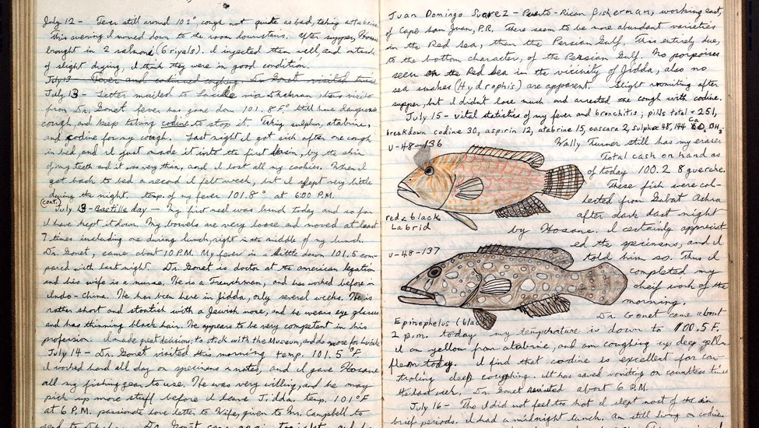
Taking Notes
Taking notes is essential for success in this course.
Doing so means you can use them on tests.
You cannot rely on simply reading the slides:
A lot will be said that is not on the slides.
You should turn in your notes before Monday of the following week using git.
PDF or plain text, Word will not be accepted.
If you do, you get a prize: you can use them to create your cheat sheet!
Your goal in this course is to learn, not to pass.
Unlike high school, you do not cram, test and forget.
Many of you will try, and you will not succeed.
Notes:
Stock photograph taken from the Internet.

Slide 19
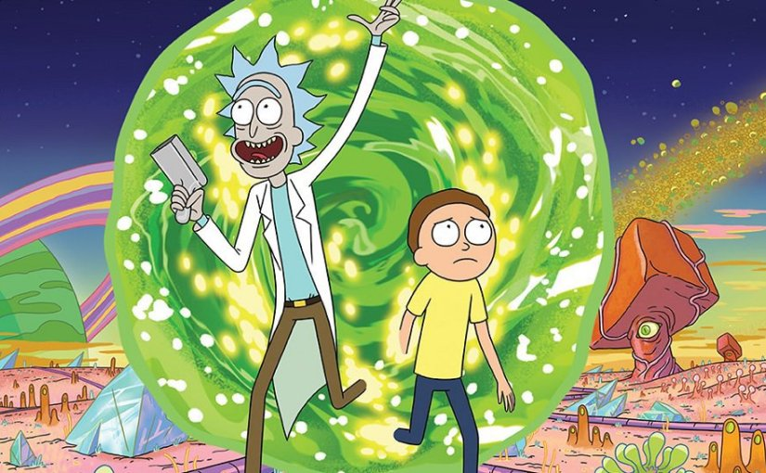
Use of Electronics
All electronics are forbidden during quizzes and examinations.
That means phones are off unless you have a waiver.
You can use your computer or tablet to take notes.
Your phone should be off, set to silent or vibrate during class.
During class you may not watch videos, shop, play video games, or post on social media.
If you do, then you will be ejected from Zoom.
Notes:
The image of Rick & Morty was taken from the Internet.

Slide 20

Secrets of Success
Start projects early.
You can always finish early and take the last day off …
Write your design document before writing code.
Think first, code second.
Use debugging and analysis tools.
You can study together but
All code must be your own!
If you don’t understand something, then ask.
Do not wait until the last minute!

Slide 21
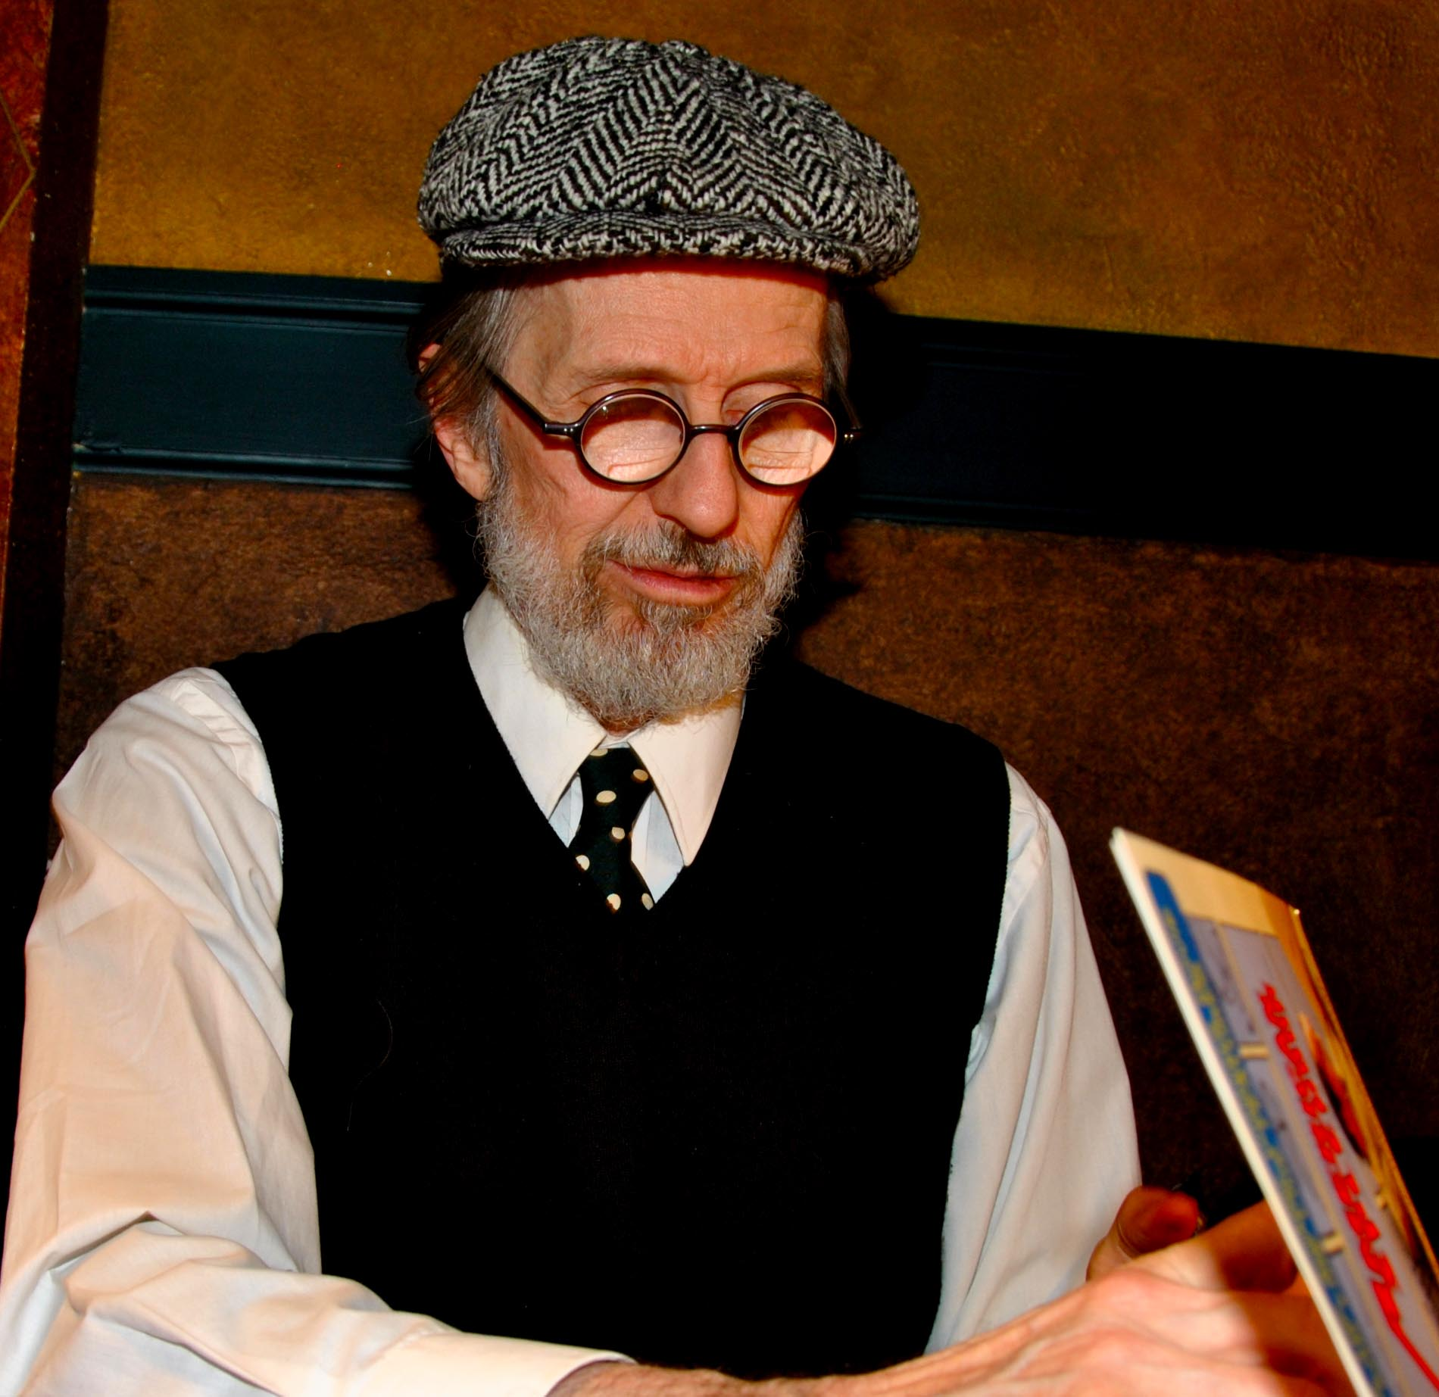
Programming Aphorisms
Computers do exactly what they’re told, not what you want them to do.
Finding bugs can be time consuming.
When you fix one bug, you may introduce new ones.
Attention to detail matters.
Time spent thinking is repaid manifold in time saved coding.
Take the time to draw diagrams, work through examples, … it will pay off.
Coding is like poetry; you should go through multiple drafts.
R. Crumb, a true Subgenius

Slide 22
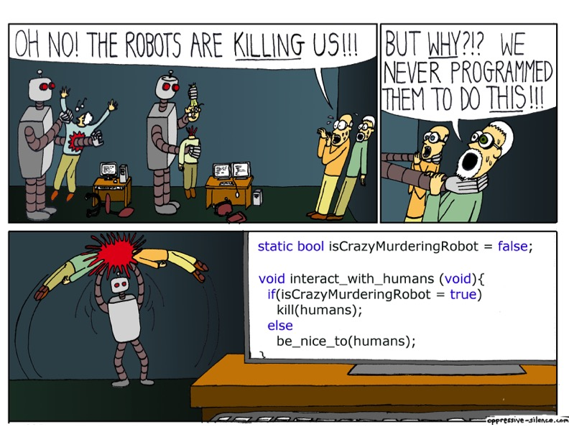
Attention to Detail Matters
Do you see the bug in this code?

Slide 23
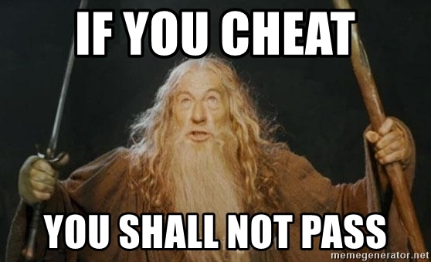
Cheating
You should all know what cheating is,
But in case you do not, you will all be signing an acknowledgement regarding it.
Using code that you did not write is cheating,
Including code on the Internet.
If you use code from others, including the TA, Grader, Tutor, … you must acknowledge that person.
You had better not use Chegg or similar web sites.
Notes:
This meme was taken from the Internet.

Slide 24
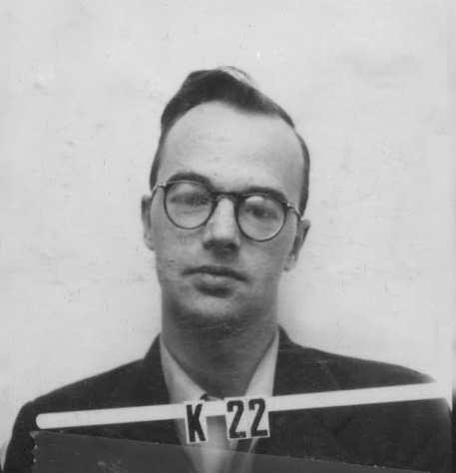
Examples of Prohibited Activity
You may not work on your assignment with anyone.
You may not show your code or design to anyone.
You may not have anyone “walk you through” an assignment, describe a solution in detail, or sit with you as you work on it.
This includes hired tutors.
You may not post code from your project on-line in questions when you ask others for help.
You may not hire some guy from Pakistan to write your code for you.
Yes, people have tried this (and failed).
This list is not exhaustive.
Klaus Fuchs
Engaged in very prohibited activities
Notes:
Do kids still read Mad Magazine?

Slide 25
The Internet does not have all of life’s answers
Avoid the temptation to “just Google it”
Your task is to think and to learn.
We know how to use the Internet too, and if you copy code we will probably catch you.

Slide 26
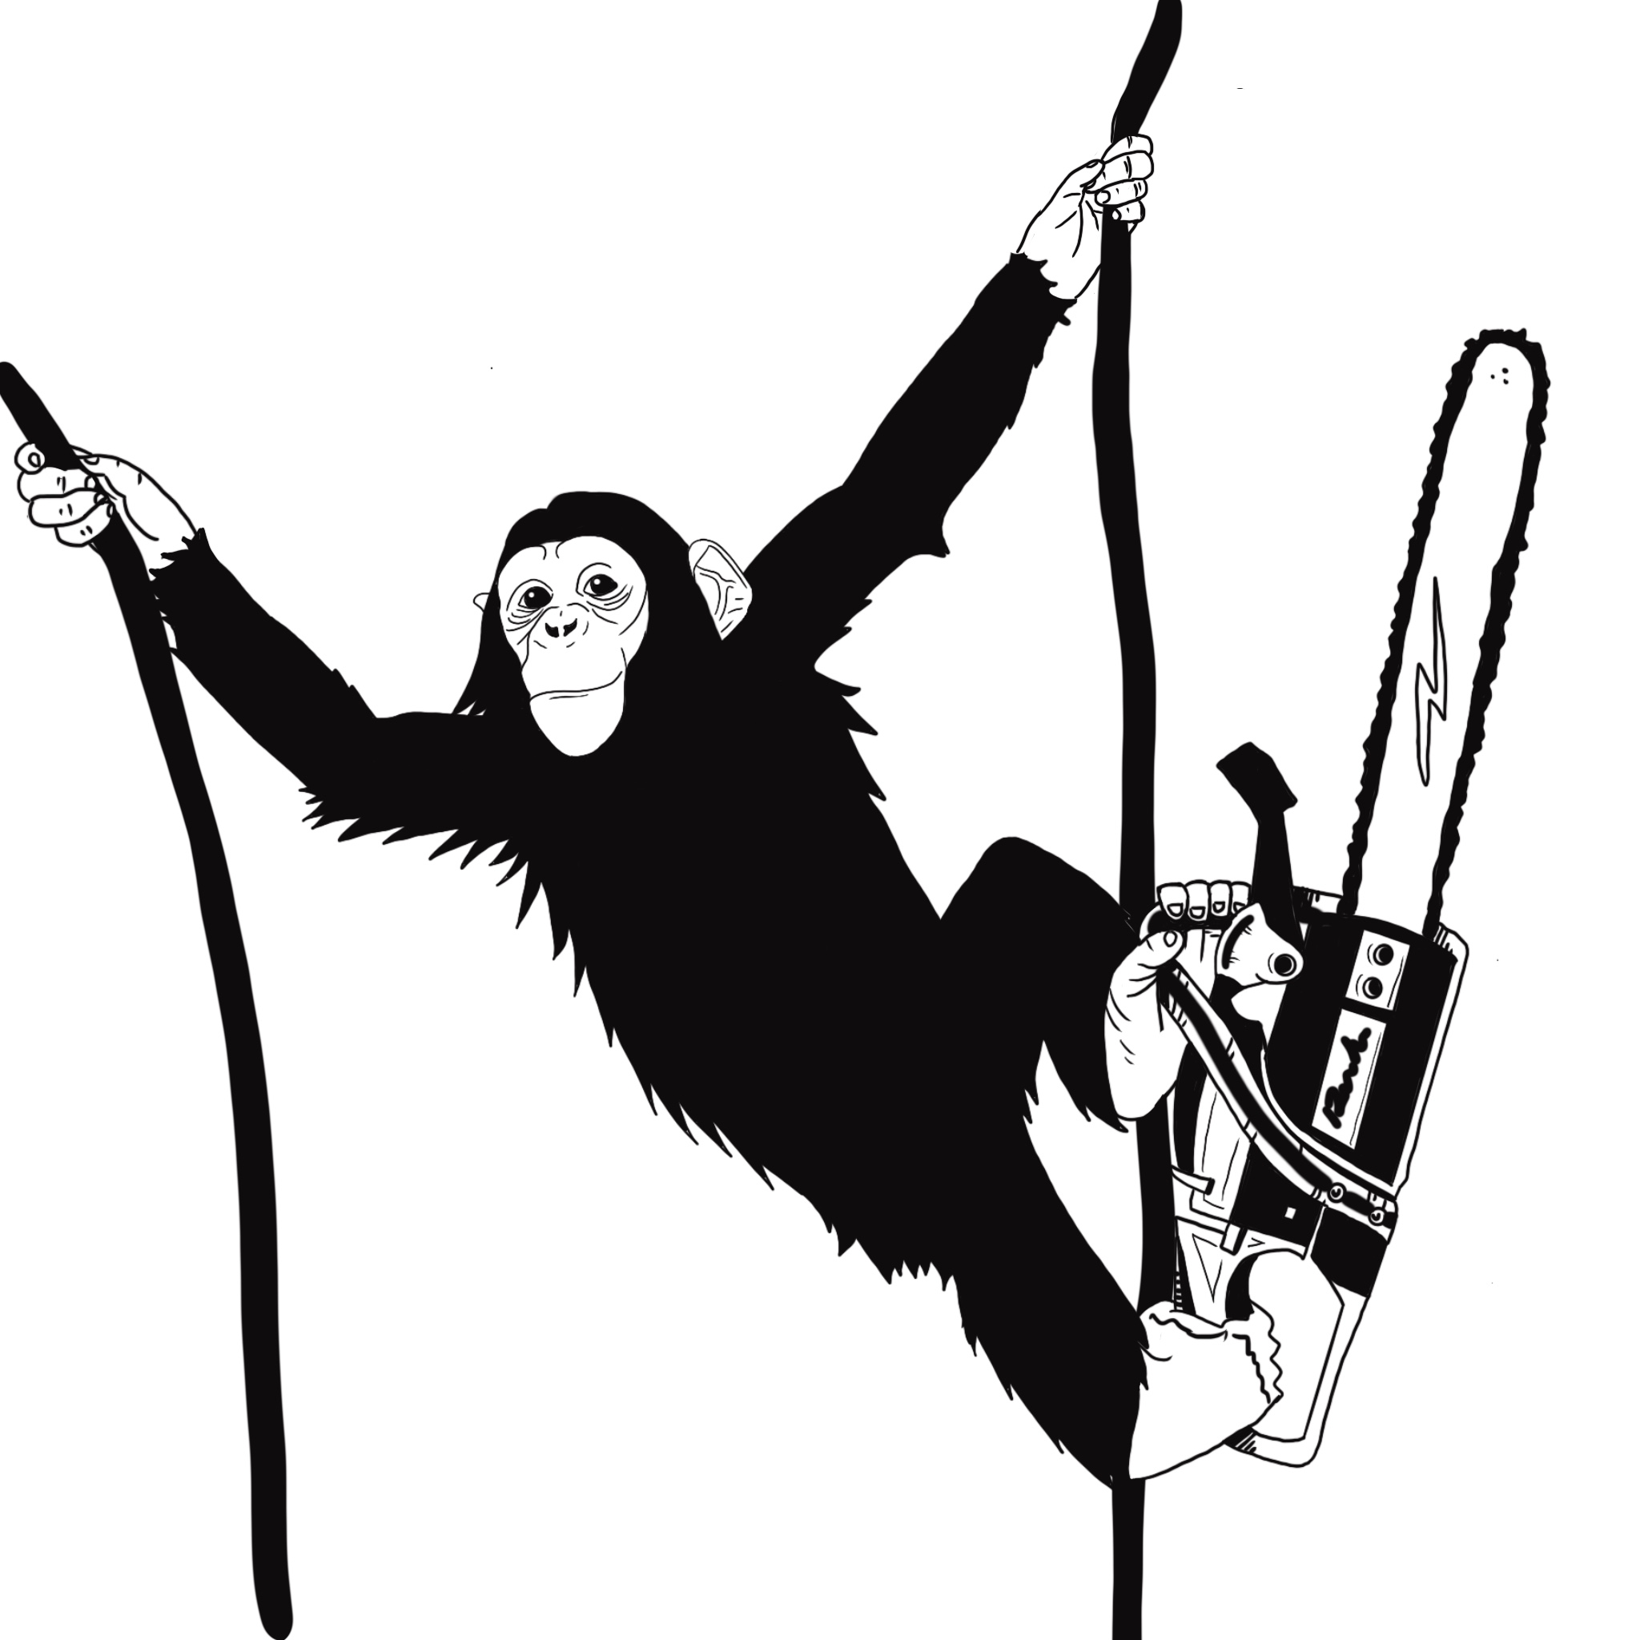
Programming Schedule
Programs are assigned by Saturday night.
Design documents are due Thursday night.
Preliminary design is 50% of the grade, and
Final design is the other 50% of the grade.
Programs are due on Sunday night.
No design on Thursday? Zero on the design document — no excuses!

Slide 27
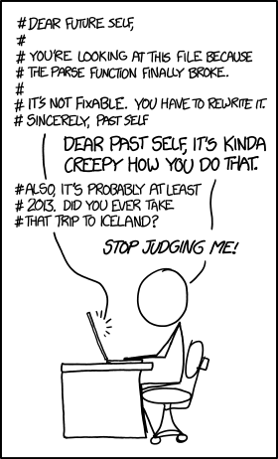
README.md
Describes:
What your program does,
How to build it,
How to run it, and
Any issues that it has.
Must be in Markdown format.

Slide 28
DESIGN.pdf
Describes how you will approach writing the program.
It should be at a level that a programmer of your level could write the program.
It should not include C code —
This is design, not programming.
Pictures, diagrams, pseudocode are what we want.
It must be in PDF.
The first version must be pushed on Thursday.
This is not final but must show substantial effort.
This counts 50%.
The final version must be pushed on Sunday.
This counts for 50%.
If you do not push on Thursday, you get zero.

Slide 29

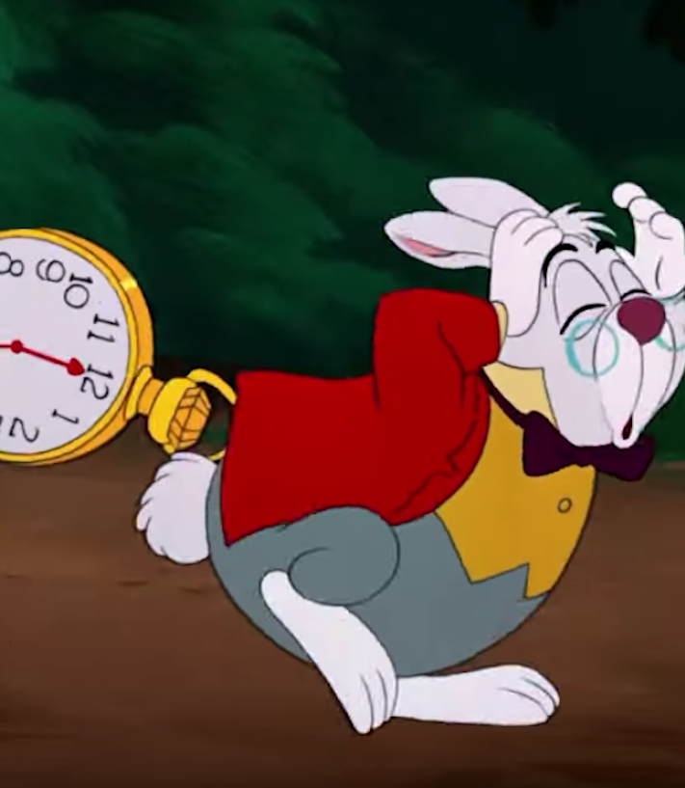
Late Policy
If you turn in your programs late, then you lose:
25% each day for up to 3 days.
After 3 days you get a zero.
There are very few valid excuses.
“But the dog ate my computer!”
Using git lets you recover!
You’ve been admonished to start early!

Slide 30
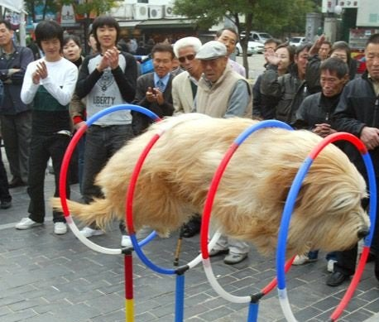
Summary
This class is not just another hoop for you to jump through:
You will use what you learn here from now on.
Take notes.
Ask questions.
Read the book.
Write the code.
Do not cheat:
It hurts you most of all.
Succeeding in this class will make subsequent classes much easier.
Your success is our goal!

